Slide 1
MIS 633-B Final Presentation
Developing a Data Warehouse &
Business Intelligence system
For Uptown Brew
Group-10 Members:
Richard Nyhus
HarshaVardhan Reddy Putta
Paras pandhree
Venkata Jaya Chandra Mullapudi
Aishway Pauranik

Slide 2
Introduction
Across US coffee culture, however, one establishment bucks the trend and has persisted in spite of the third wave of coffee. This is the diner, which is now irrevocably intertwined with how people perceive coffee in the US.
Since the founding of the US’ coffeehouses before the American Revolution, coffee shop culture in the country has evolved significantly. From war rations to the third wave, it’s clear that coffee has been an inextricable aspect of US culture for centuries.
According to the overview led by the National Coffee Association in the United States, over 70% of the customers like at-home espresso readiness, and 59% of the espresso consumed everyday is a connoisseur espresso. Subsequently, a steady shift has been seen from soda pops to espresso drinks among buyers in the locale as of late.
The penetration rates of single-serve brewers in households in the largest cities in the United States is approximately 23% to 75%. In the United States, single-cup brewers are found in 41% of homes and 28% of offices, according to the National Coffee Drinking Trends survey

Slide 3

Company Overview: Uptown Brew

Slide 4
Company Overview: Uptown Brew
Uptown Brew is a New York-based coffee chain with 1 warehouse and 8 brick-and-mortar locations in New York.
Uptown Brew sells perishable and non-perishable goods such as bakery goods, coffee, and merchandise.
In recent years, it has consistently generated an annual income of approx. $8.75 million.
It is currently stated goal for its first quarter of this decade is to expand operations to bay areas and mid-Atlantic states and begin marketing its products and merchandise to new customers.
Hence, the Coffee chain still possesses a highly outdated legacy in the Bi team, with the MongoDB server as the database but disjoined reporting and lack of data knowledge across the groups of the organization.

Slide 5
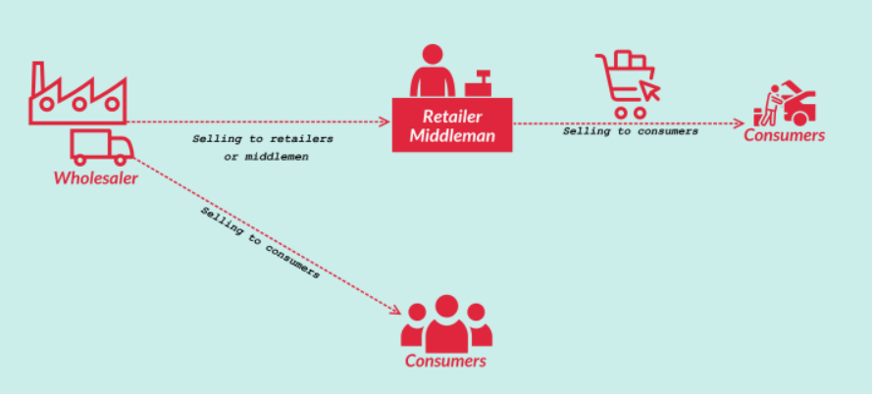
Systems Problem/Solution

Slide 6
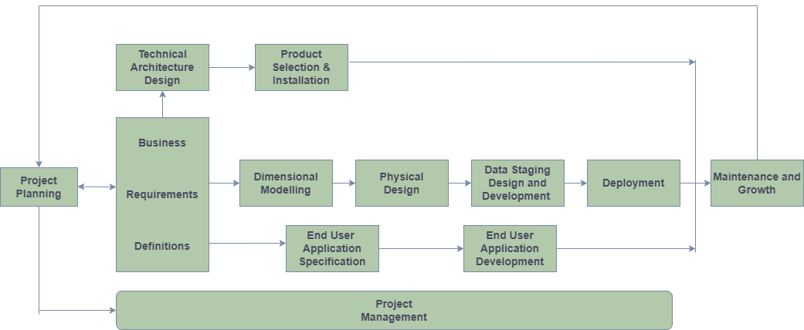
Business Lifecycle Approach

Slide 7
Opportunity Matrix
Business Process / Event | Sales | Logistics / Shipping | Customer Service / Marketing | Operations / Finance
1. In-store Sales Transactions |  |  | X | X
2. Shipping Sales Transactions |  | X
3. Processing In-store Transactions | X
4. Processing Supplier Transactions | X
5. Refresh Inventory |  | X |  | X
6. Priority Customer Identification |  |  | X

Slide 8
Bus Architecture Matrix
Business Process / Event | Date | Product | Payment Method | Customer | Staff | Sales Outlet | Shipping
1. In-store Sales Transactions | X | X | X | X | X | X
2. Shipping Sales Transactions | X | X | X |  | X |  | X
3. Processing In-store Transactions | X | X | X |  | X | X
4. Processing Shipping Transactions | X | X | X |  | X | X | X
5. Refresh Inventory |  | X | X |  |  |  | X
6. Priority Customer Identification |  |  |  | X |  | X

Slide 9
Prioritization Grid
High
BP 2
BP 1
BP 3
BP 5
BP 4
Potential Business Impact
BP 6
Low
Low
Feasibility
High

Slide 10
Data Transformation
After extraction, the information should be changed. For example, bringing together information types, managing spelling blunders, wiping out information uncertainty, and parsing into standard configurations. Information change is normally the most intricate part. It is additionally the longest advance in ETL improvement. The scope of information change is extremely wide. The interaction is to change the information from basic information type to very intricate information cleaning innovation.
(7) Data Transformation Rules:
Only specific data columns are loaded
Unified coding
Reordering improves query performance
Merge data sources and remove duplicates
Row column Transformation
Merge duplicate columns
Data validation

Slide 11
Logical Fact Diagram
Staff
Payment
Method
Product
Sales
Summary
Fact
Sales
Detailed
Fact
Customer
Relationship
Shipping
Date
Sales Outlet

Slide 12
High End Data Model
Product
Product
Bridge
Payment
Method
Customer
Transaction
Date
Sales Transaction Fact
Date
Staff
Order
Date
Sales Outlet
Shipping

Slide 13
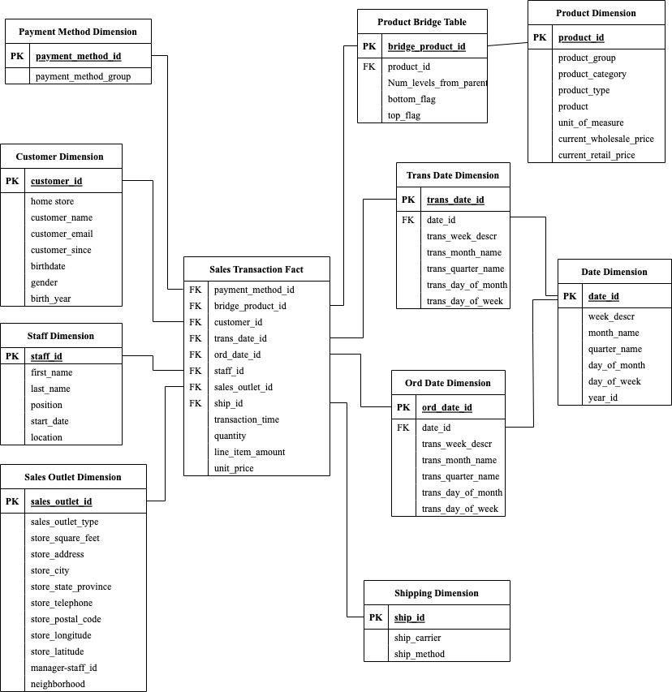
Star Schema

Slide 14
Dimension Attribute Description: Product Dimension
Name | Description | Cardinality | Slowly Changing Dimension Policy | Sample Values
Product id | Unique value used to identify each product. | 89 | No Update | 1, 2, 3, 4, 5, 6, 7, 8, 9… 89.
Current Wholesale Price | Purchase cost for each item (per unit). | x | Type 2 | x
Current Retail Price | Sale price for each item (per unit). | x | Type 2 | x
Unit of Measurement | Unit of measure for each item sold. | 12 | Type 2 | 1 lb, 24 oz, 16 oz, 12 oz, 8 oz, 6 oz, 1 oz, etc.
Product Type | Type within a product category that a product is associated with. | 31 | Type 1 | Organic Beans, Herbal tea, Drinking Chocolate, etc.
Product Category | Category within a product group that a product is associated with. | 9 | Type 1 | Coffee beans, Loose Tea Coffee, Tea, Bakery, etc.
Product Group | A general group of products that a product is associated with. | 5 | Type 1 | Whole Bean/Teas, Food, Add-ons, Beverages, Merchandise.

Slide 15
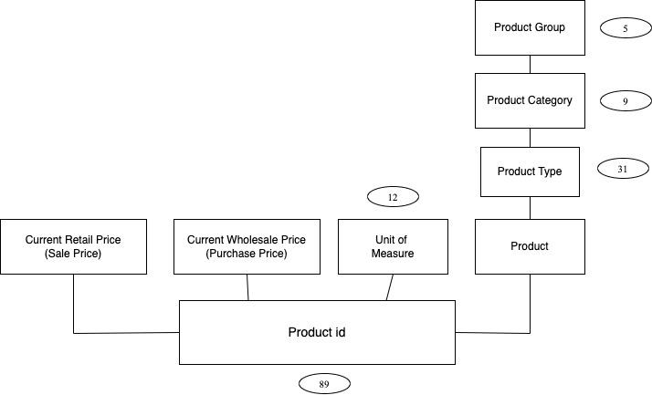
Dimension Table Diagram: Product Dimension

Slide 16
(3) Delivery Steps of Conformed Dimension:
Standardization: The purpose of standardization is to make the data coding methods and data formats of different data sources from different branches to the same, to lay a foundation for the next data matching.
Matching and duplication: Two aspects of data matching: one is to match the identification of different data sources and different attributes of the same thing to make the data more perfect; The other is to identify the same data from different data sources as duplicates, to lay a foundation for filtering in the next step
Surviving: Main purpose of data filtering is to select the conformed dimension as the master data, the final delivered conformed dimension data

Slide 17
(4) Conformed Dimensions in Uptown Brew’s DW
Date Dimension
Customer Dimension
Product Dimension
Sales Outlet Dimension

Slide 18
Conformed Dimensions (cont’d.)
Sales Outlet
Customer
Sales
Summary
Fact
Sales
Detailed
Fact
Product
Date

Slide 19
Two Way Aggregate Table
Product ID | Quantity | Product Category | Order Date | Transaction Date | Customer Name | Store Outlet
52 | 1 | Tea | 3/26/2019 | 4/1/2019 | Melissa Johnson | 3
47 | 1 | Tea | 3/24/2019 | 4/2/2019 | Sean | 5
74 | 1 | Food | 3/28/2019 | 4/8/2019 | Teegan | 5
83 | 1 | Merchandise | 3/30/2019 | 4/11/2019 | Brady | 8

Slide 20

OLAP MDDB Cube
Year
2019(2)
2019(1)
2018(2)
2018(1)
Product Category, Neighborhood,
and Year
are all Dense Dimensions
Coffee
Product
Category
Tea
Bakery
Jamaica
Neighborhood
Astoria
Chelsea
Notes:
The dimension Product Category, Neighborhood, and Year are all Dense Dimensions

Slide 21
What is Business Intelligence?
Business intelligence (BI) is the process of transforming data into actionable insights that help an organization make strategic and tactical choices. To offer users with detailed insight about the state of the business, BI tools access and analyze data sets and show analytical findings in reports, summaries, dashboards, graphs, charts, and maps.
The phrase "business intelligence" is also used to describe a set of technologies that enable quick, easy-to-understand access to data-driven insights about an organization's current status.
For example, an organization that wants to better manage its supply chain needs BI capabilities to discover where delays are occurring and where variances exist within the shipping process. That organization might also utilize its business intelligence capabilities to figure out which products are the most frequently delayed, as well as which forms of transportation are the most frequently implicated in delays.

Slide 22
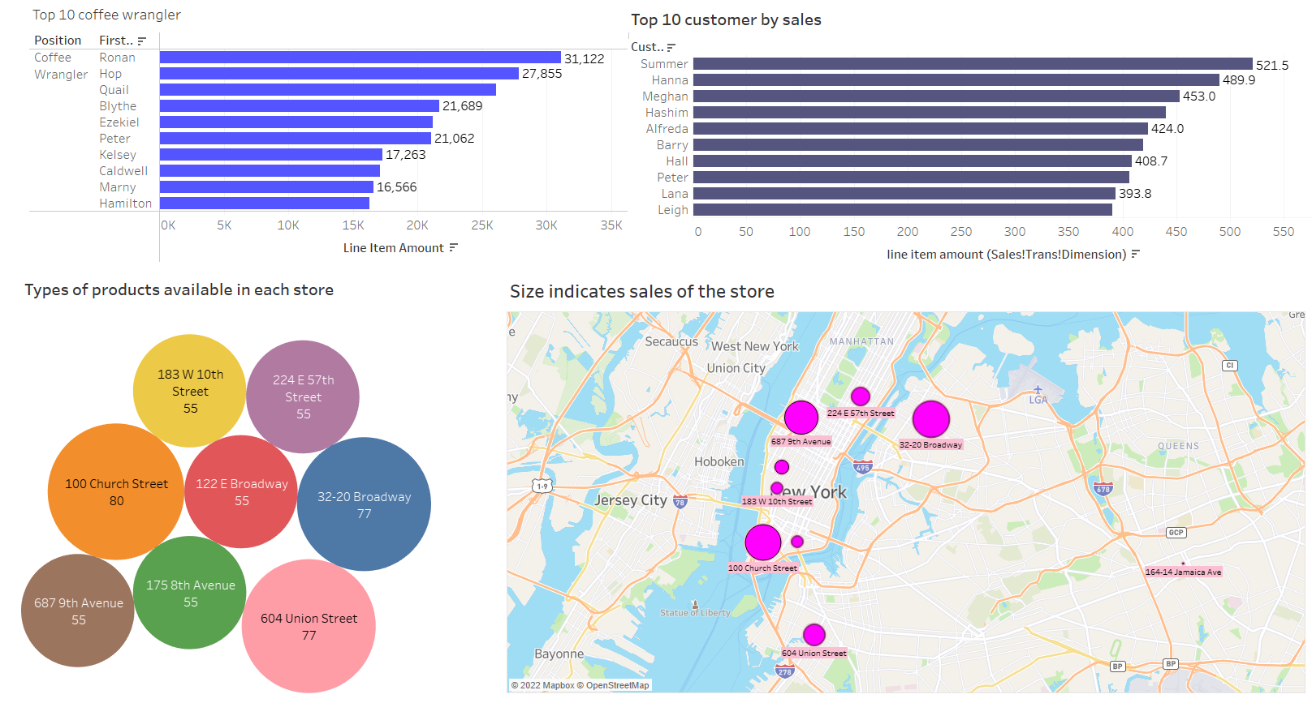
Executive Dashboard

Slide 23
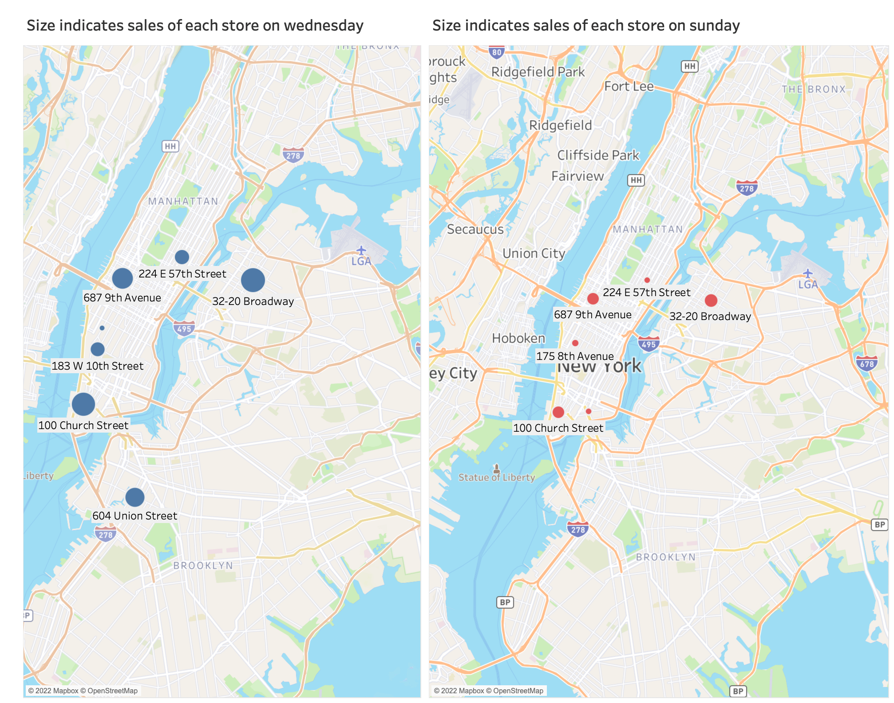
Sales Comparison Between Wednesdays and Sundays

Slide 24
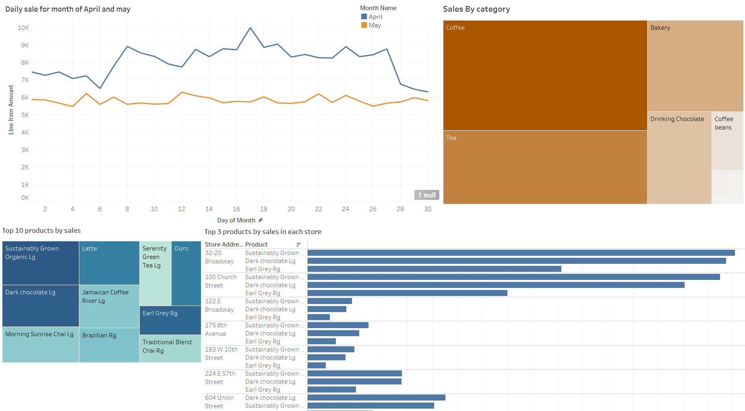
Sales Manager Dashboard

Slide 25
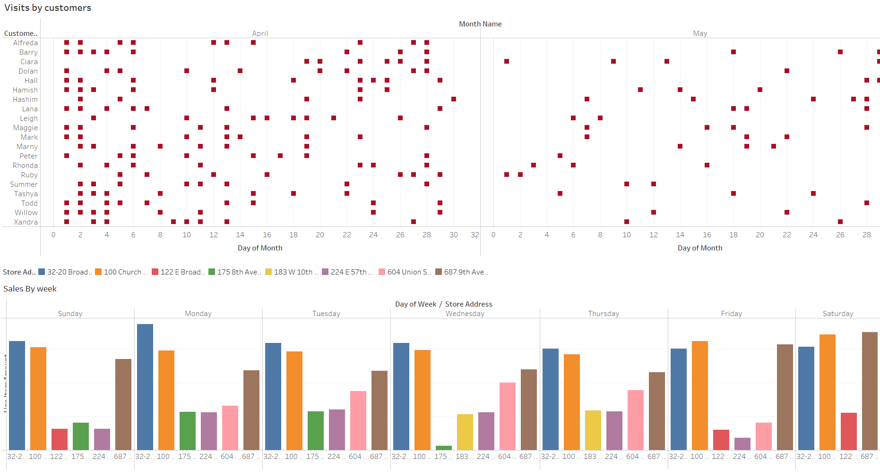

Slide 26
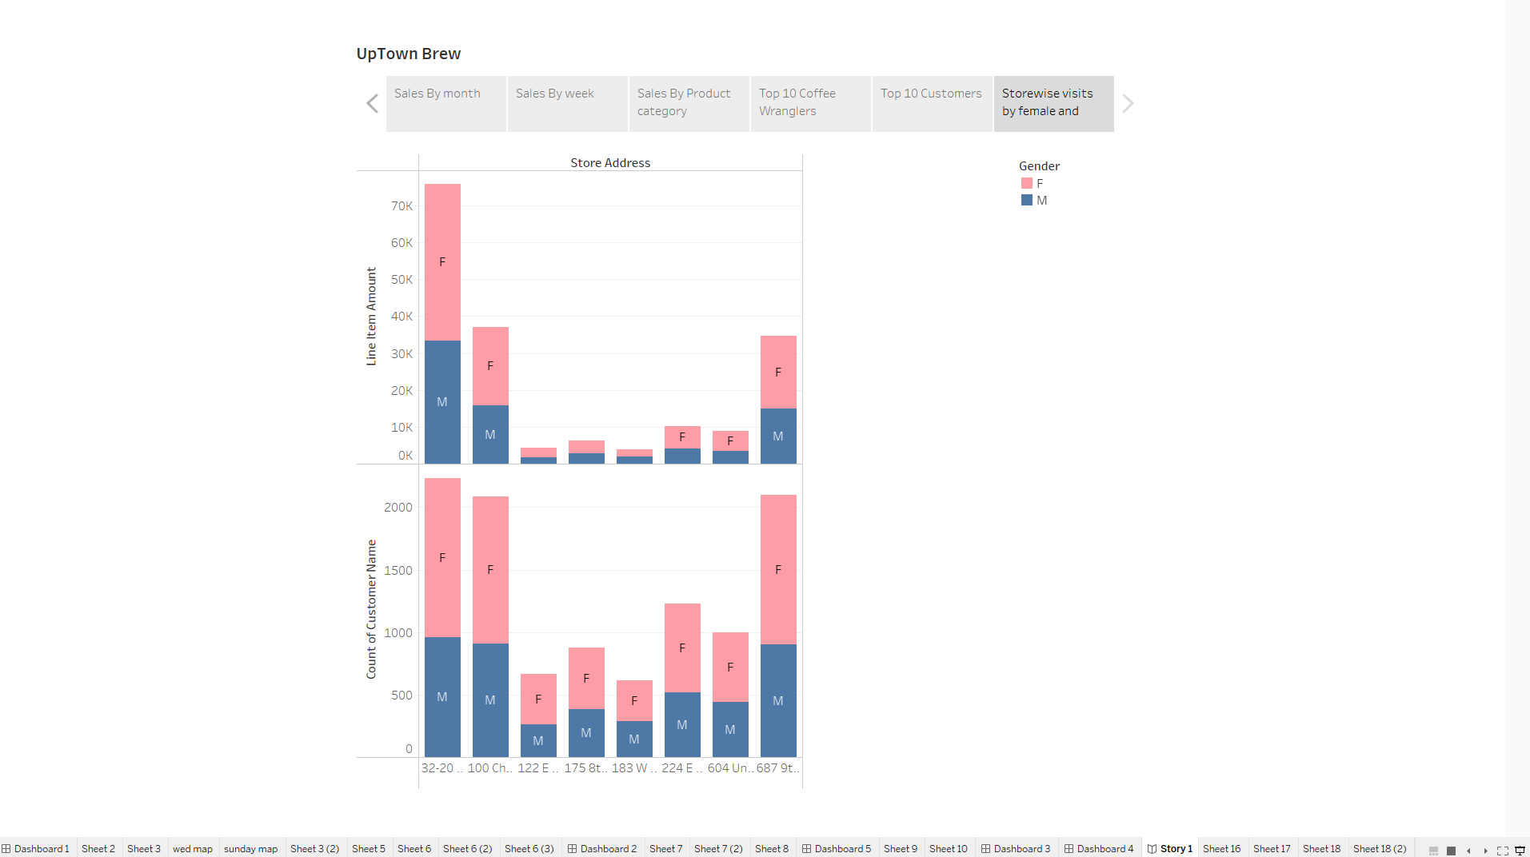
Storyboard

Slide 27
Q&A

